Slide 1
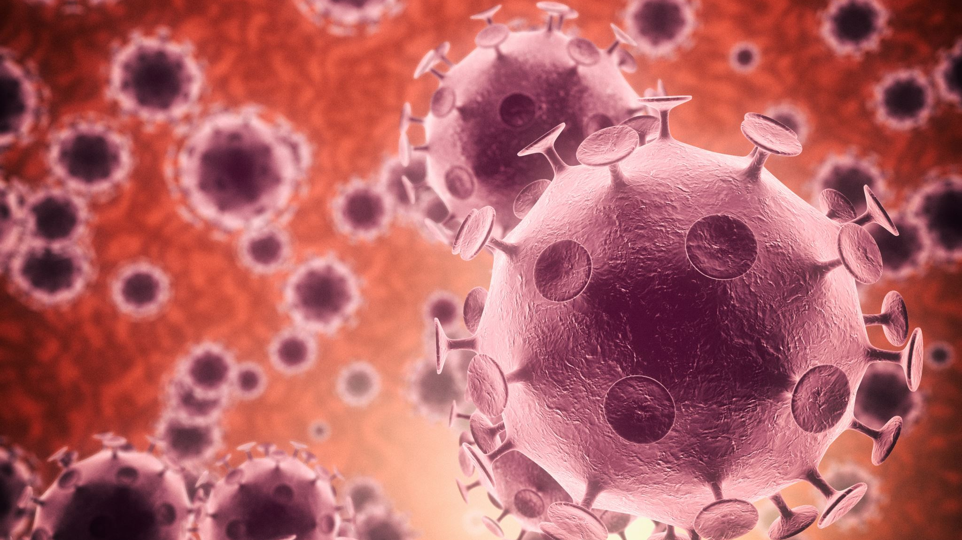
Infectious disease epidemiology

Slide 2
Operational definitions
Infection - The entry and development or multiplication of an infectious agent in an organism, including the body of man or animals. It also implies that the body responds in some way to defend itself against the invader, either in the form of an immune response or disease.
Colonization
Subclinical
Latent infection
Clinical infection
Contamination - The presence of an infectious agent on a body surface also on or in clothes, beddings, toys, surgical instruments or dressings, or other inanimate articles or substances including water, milk and food.
Infestation - For persons or animals the lodgment, development and reproduction of arthropods on the surface of the body or in the clothing

Slide 3
Host - A person or other living animal, including birds and arthropods, that affords subsistence or lodgement to an infectious agent under natural (as opposed to experimental) conditions.
Obligate host
Definitive hosts
Intermediate hosts
Transport host
Infectious disease - A disease due to an infectious agent. While some infectious diseases are contagious, others are noncontagious. All infectious diseases and infestations are communicable diseases
Contagious disease
Communicable disease - An illness due to a specific infectious agent or its toxic products that arises through transmission of that agent or its products from an infected person, animal, or reservoir to a susceptible host, either directly or indirectly through an intermediate plant or animal host, vector, or the inanimate environment

Slide 4
EPIDEMIC - [Epi (upon), demos (people)]. The occurrence in a community or region of cases of an illness, specific health related behaviour, or other health-related events clearly in excess of normal expectancy.
Epidemicity is thus relative to usual frequency of the disease in the same area, among the specified population, at the same season of the year.
ENDEMIC - (En = in; demos=people). It refers to the constant presence of a disease or infectious agent within a given geographic area or population group, without importation from outside; may also refer to the “usual” or expected frequency of the disease within such area or population group.
Hyper-endemic
Holo – endemic

Slide 5
SPORADIC – scattered; The cases occur irregularly, haphazardly from time to time, and generally infrequently
PANDEMIC - An epidemic occurring over a very wide area, crossing international boundaries, and usually affecting many people. Only some pandemics cause severe disease in some individuals or at a population level.
Characteristics of an infectious agent influencing the causation of a pandemic include : the agent must be able to infect humans, to cause disease in humans and to spread easily from human to human.
EXOTIC - Diseases which are imported into a country in which they do not otherwise occur.

Slide 6
ZOONOSES - An infection or infectious disease transmissible under natural conditions from vertebrate animals to man. May be enzootic or epizootic
(a) anthropozoonoses : infections transmitted to man from vertebrate animals, e.g., rabies, plague, hydatid disease, anthrax and trichinosis;
(b) zooanthroponoses : that is, infections transmitted from man to vertebrate animals, e.g., human tuberculosis in cattle
(c) amphixenoses - that is infections maintained in both man and lower vertebrate animals that may be transmitted in either direction, e.g., T.cruzi, and S.japonicum
NOSOCOMIAL INFECTION
OPPORTUNISTIC INFECTION
IATROGENIC INFECTION

Slide 7
DYNAMICS
SOURCES and RESERVOIR
The source of infection is defined as “the person, animal, object or substance from which an infectious agent passes or is disseminated to the host”.
A reservoir is defined as any person, animal, arthropod, plant, soil or substance (or combination of these) in which an infectious agent lives and multiplies, on which it depends primarily for survival, and where it reproduces itself in such manner that it can be transmitted to a susceptible host”
Human reservoir – Cases, Carrier
Animal Reservoir
Non – living reservoir

Slide 8
Cases
Primary case refers to the first case of a communicable disease introduced into the population unit being studied.
Index case refers to the first case to come to the attention of the investigator.
Secondary cases are those developing from contact with primary case.
A suspect case is an individual (or a group of individuals) who has all of the signs and symptoms of a disease or condition, yet has not been diagnosed as having the disease or had the cause of the symptoms connected to the suspected pathogen.

Slide 9
Carrier – By type
Incubatory - Those who shed the infectious agent during the incubation period of disease
Convalescent - Those who continue to shed the disease agent during the period of convalescence, e.g., typhoid fever, dysentery (bacillary and amoebic), cholera, diphtheria and whooping cough. In these diseases, clinical recovery does not coincide with bacteriological recovery. A convalescent carrier can pose a serious threat to the unprotected
Healthy - Healthy carriers emerge from subclinical cases. They are victims of subclinical infection who have developed carrier state without suffering from overt disease, but are nevertheless shedding the disease agent, e.g., poliomyelitis, cholera, meningococcal meningitis, salmonellosis, and diphtheria

Slide 10
Carrier – By duration
Temporary - Temporary carriers are those who shed the infectious agent for short periods of time.
Chronic - A chronic carrier is one who excretes the infectious agent for indefinite periods. Chronic carriers are far more important sources of infection than cases. The longer the carrier state, the greater the risk to the community.

Slide 11
Carrier – By portal of exit
Urinary
Intestinal
Respiratory
Nasal
Skin eruptions

Slide 12

Modes of transmission
Direct
Direct contact
Droplet (30 – 60cm)
Contact with soil
Inoculation with skin or mucosa
Transplacental
Indirect
Vehicle borne
Vector borne – mechanical / biological
Air borne – droplet nuclei / dust
Fomite borne
Unclean hands and fingers

Slide 13
Vector borne disease
By vector – invertebrate or vertebrate
Transmission chain
Man and a non-vertebrate host
1) Man-arthropod-man (malaria)
2) Man-snail-man (schistosomiasis).
Man, another vertebrate host, and a non-vertebrate host
1) Mammal-arthropod-man (plague)
2) Bird-arthropod-man (encephalitis).
Man and 2 intermediate hosts
1) Man-cyclops-fish-man (fish tape worm)
2) Man-snail-fish-man (Clonorchis sinensis)
3) Man-snail-crab-man (Paragonimiasis).
Method of transmission
Biting
Regurgitation
Scratching
Contamination with body fluid of vector

Slide 14
Susceptible host
Successful parasitism
Portal of entry
Site of election
Portal of exit
Survival in external environment

Slide 15
Incubation period
“The time interval between invasion by an infectious agent and appearance of the first sign or symptom of the disease in question”.
Median incubation period - time required for 50 per cent of the cases to occur following exposure
Depend on – generation time, infective dose, portal of entry, individual susceptibility
Importance – tracing the source of infection
Period of surveillance
Immunization
Identification of point source / propagated epidemic
Prognosis

Slide 16
Serial interval – The gap in time between the onset of the primary case and the secondary case is called the “serial interval”
Generation time - the interval of time between receipt of infection by a host and maximal infectivity of that host
Communicable period - “the time during which an infectious agent may be transferred directly or indirectly from an infected person to another person, from an infected animal to man, or from an infected person to an animal, including arthropods”

Slide 17
Specific defenses
Active – clinical infection, subclinical / inapparent infection, immunization
Passive immunity - immunoglobulin, maternal Ab
Herd immunity

Slide 18
Prevention
 | Individual | Family | Community
Primary
Secondary
Tertary

